Slide 1
Engaging Business and Community Partners in New Roles Educating for Careers Conference March 5, 2011
Rob Atterbury- ConnectEd
Cindy McHugh – National Academy Foundation
Notes:
Story of being bumped at a school

Slide 2
Purpose and Overview
Expand our thinking about business and community involvement
Review and reflect on new definition of involvement
Identify and develop new strategies of engagement
Understand what doesn’t work
Notes:
What does work:
Hint that it involves much of what we ask of students to be successful: Communication, Follow-through, ownership and setting measurable goals with a specific timeframe.
What doesn’t work: Talk through scenarios during table discussion of when a partnership worked well and why. Talk through challenges at engaging partners/problem solve.

Slide 3
Why are we invested?
ConnectEd Pathway Components
A Challenging Academic Component
A Demanding Technical Component
A Work-based Learning Component
Support Services
National Academy Foundation Pillars of Support
Academy Development
Advisory Board Development
Integrated Curriculum Support
Support for Work-based Learning Opportunities

Slide 4
Traditional Roles Business and Community partners
Table group brainstorm
Debrief
Notes:
When thinking about opportunities for initial engagement, ask yourself the following:
-Who (who is already connected/familiar with our academy that could help with outreach, who is located in the geographic region, who would have a vested interest in our academy theme)
-What (what do the partners want to get out of their involvement, what is a specific area of expertise, skill, trade, story they can share, what are they willing to support or champion)
-Why (Work together to commit to a specific goal such as improved attendance, higher enrollment, high numbers of students applying to two and four year colleges or trade schools, attainment of industry-specific skills)
-When (set a time-frame of when will each objective be completed and intermediate steps needed to achieve overall goals)

Slide 5
Roles of Business and Industry
Lower commitment
More commitment
Advisory Board Member
Approve curriculum and competencies
Field Trip Sites
Guest Speaker
Tutor/Mentor
Provide resources
Provide Internship

Slide 6
Additional/New roles
Committed
Really committed
Develop a vision and mission
Help to define student outcomes
Support the creation of the pathway
Provide teacher job shadowing/externship opportunities
Provide project ideas/demonstrate real-world application
Assess student work
Developing a broad-based coalition at the district level

Slide 7
Who, what, why and when?
When thinking about opportunities for partner engagement, consider the following:
Who
What
Why
When

Slide 8
Video Example
Work-based Learning

Slide 9
Question
What are the implications of this new definition on the business community?

Slide 10
Value of a Business/Community Partner
Curriculum support
A true partner
Network to others
Advocate/protect

Slide 11
Who should be included?
College partners
Business related to the academy or pathway
HR professionals
Community based organizations that support your students
Academy Director
Principal
Parents
Student representative

Slide 12
Tips on Developing Business Involvement
Tapping formal partnerships
Identifying informal partnerships
family
neighbors
social
Always on the look out
At the party
Airplane
At the grocery store
Notes:
Brainstorm each item
Professional industry associations, Rotary, Chamber, Kiwanis
Social: Social Networking Sites
Student alumni

Slide 13
Return on investment for business
Reasons for being involved
Improved employee learning, productivity and morale
Favorable publicity
Increased networking
Increased diversity
Clearer focus for future engagement
A stronger system for developing skilled workers in the industry
Greater exposure in the market(s) served by the company

Slide 14
What doesn’t work for business community partners
Asking for money
Not having an ask
No clear role
Not listening to the advice or having an answer for every suggestion “Yea, we tried that” or “We’re doing that already”
Over complicate
Not engaging them with students

Slide 15
How to build a strong, well run advisory board
Business chair
Communication system
Agendas and minutes from meetings with clear action steps
Action on recommendations
Engagement with students
Providing a sense of true engagement
Clear about the “ask” at all times
Inviting suggestions and listening to them
By Laws- 501c3 foundation
Notes:
-Set objectives (see Advisory Board storymap)
Agendas/Minutes: Quick turn-around

Slide 16
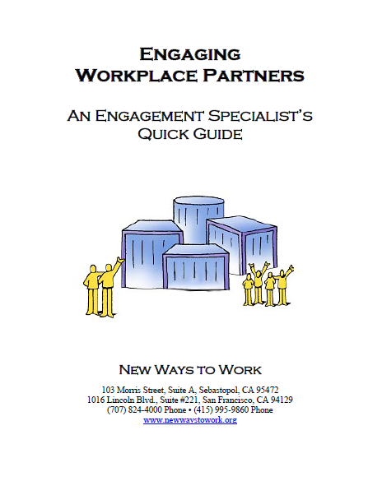
Resources
WBL in CA Report - Irvine Foundation
New Ways to Work
AB 2648 Report – WestEd or CDE
The Gold Standards for HS Internships - National Academy Foundation
Partnership Guide - CASN

Slide 17
Additional Information
National Academy Foundation Website:
www.naf.org
Cindy McHugh
cmchugh@naf.org
ConnectEd Website:
www.ConnectEdCalifornia.org
Rob Atterbury
ratterbury@ConnectEdCalifornia.org

